Slide 1
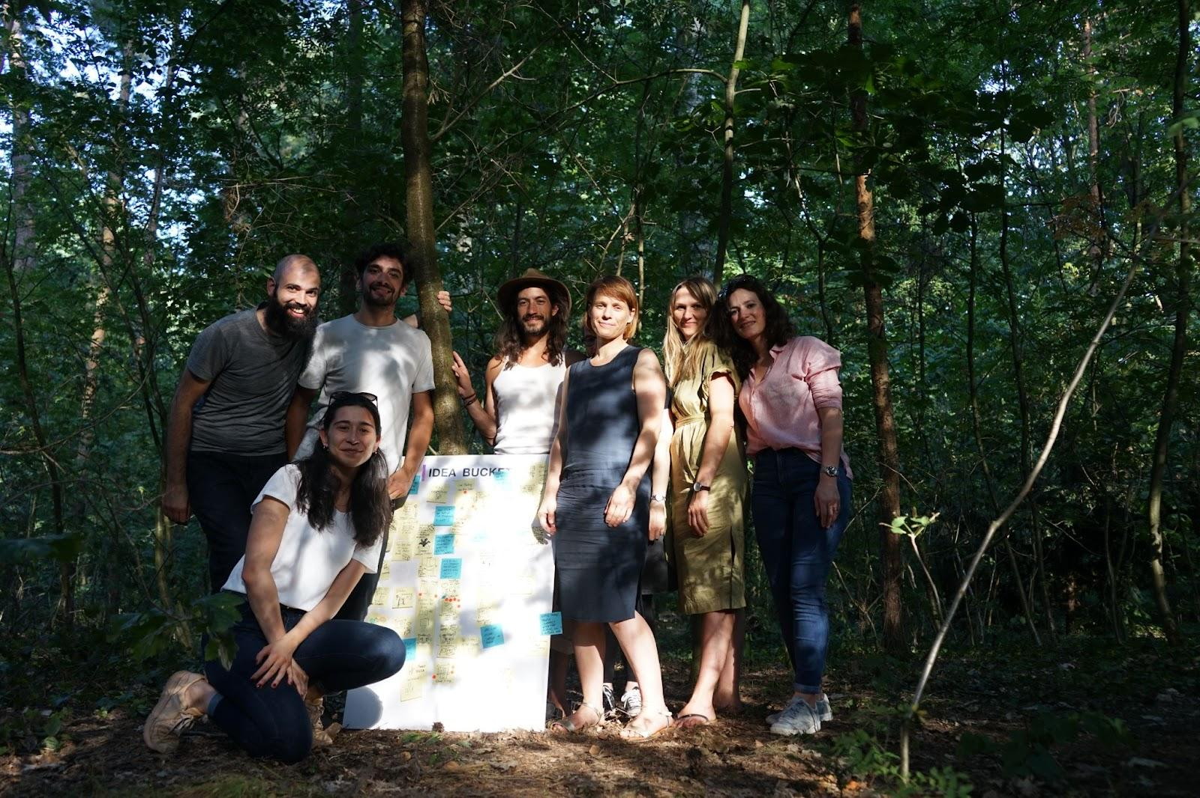
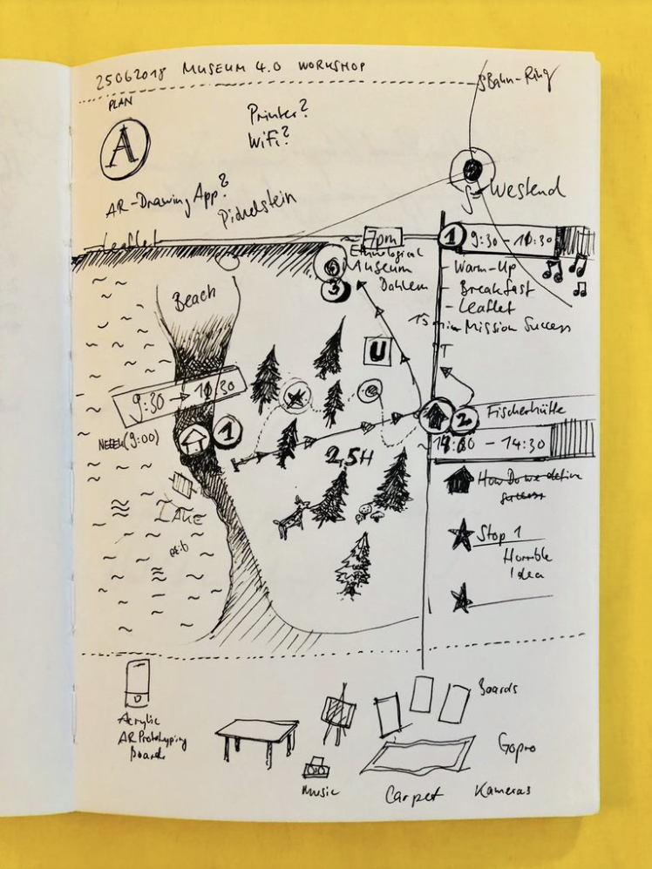

Slide 2
















About us
NEEEU Spaces is an interdisciplinary design studio based in Berlin. We specialise in the design and development of meaningful digital products and services for the cultural and public sectors.
Our core team consists of designers, researchers and developers from twelve countries. For us, creation is a truly collaborative endeavour. We love to involve organisations and institutions, as partners, all throughout our creative process.
We use a Human Centered Design approach to make sure that we place the visitors and audiences at the heart of our design process. We always make sure that the voices and expertise of our professional collaborators are included and valued, too.
In the last five years NEEEU has focused on exploring the possibilities and limits of new technologies, especially augmented reality, and created bespoke immersive experiences and products for some of Europe's most important cultural institutions such as Gropius Bau, Neue Nationalgalerie, Humboldt Forum and London Science Museum.
https://neu.io/

Slide 3




















Our Partners and Clients

Slide 4
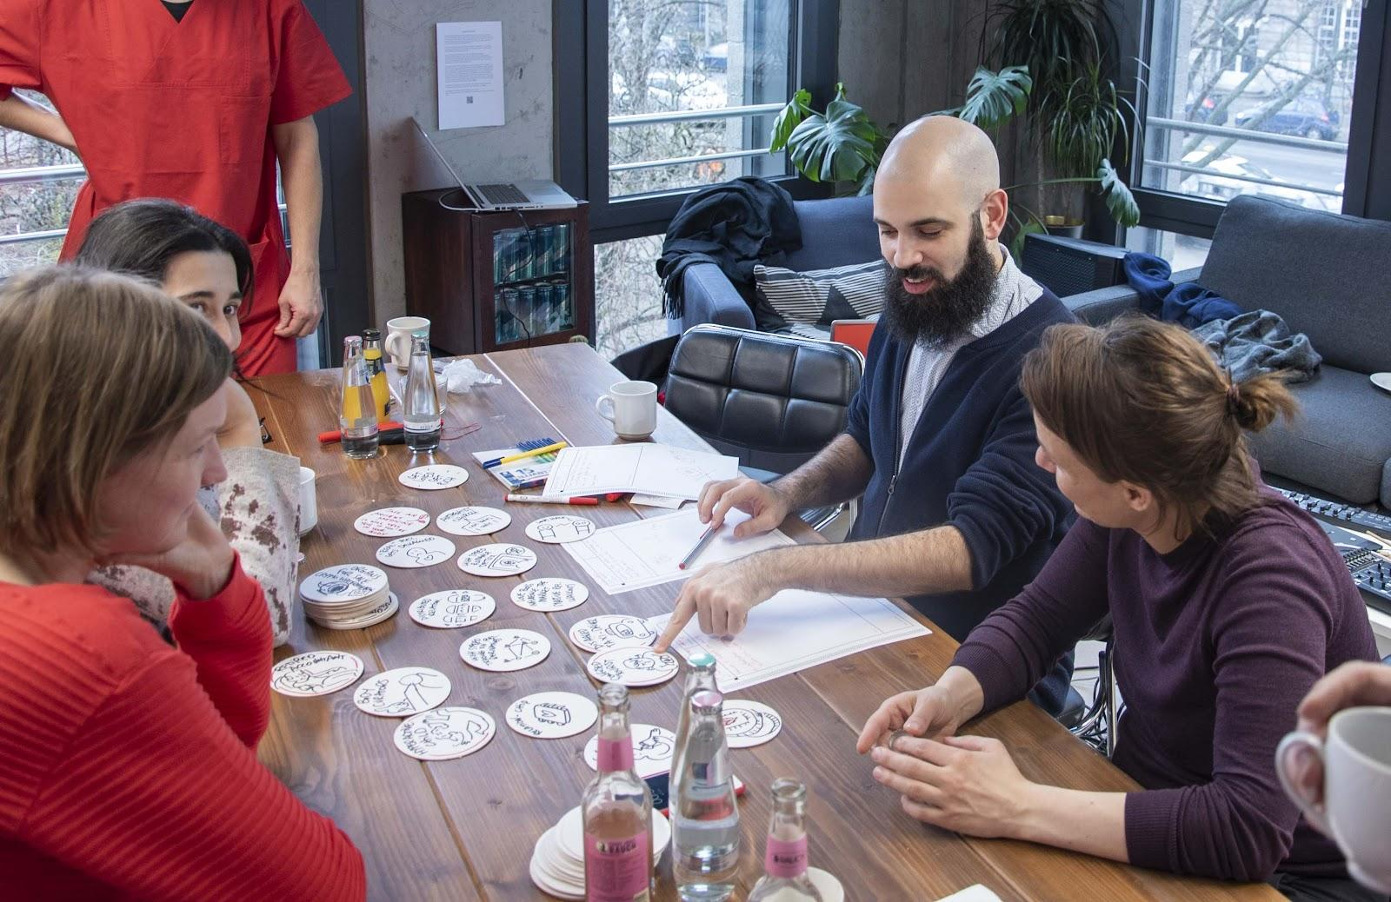
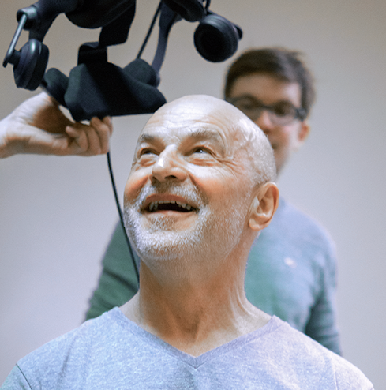
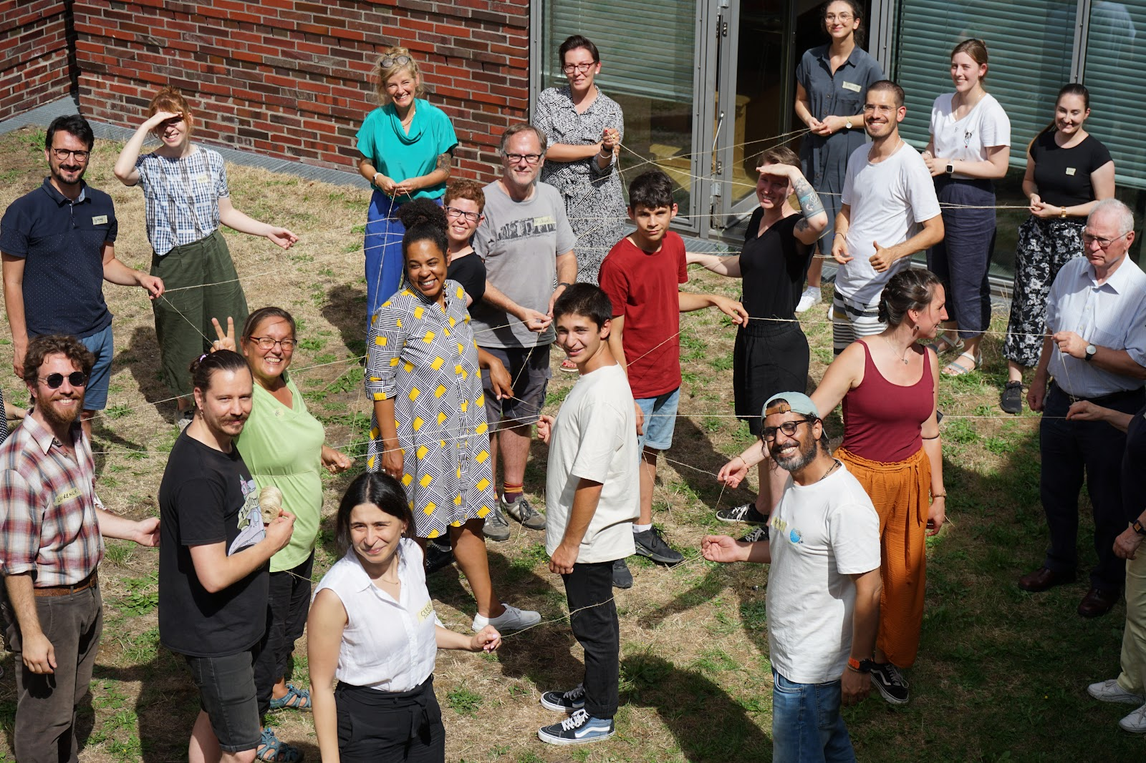
We build relationships
We believe that caring about the needs of the people you serve, and working closely with them to understand and address them, is how we can deliver the highest quality of service, product, and experience.
This is why, more than anything, we value the relationships we have built over the years with trusted partners, collaborators, and clients.
In other words: if there is a secret ingredient to NEEEU’s success, this is it!

Slide 5
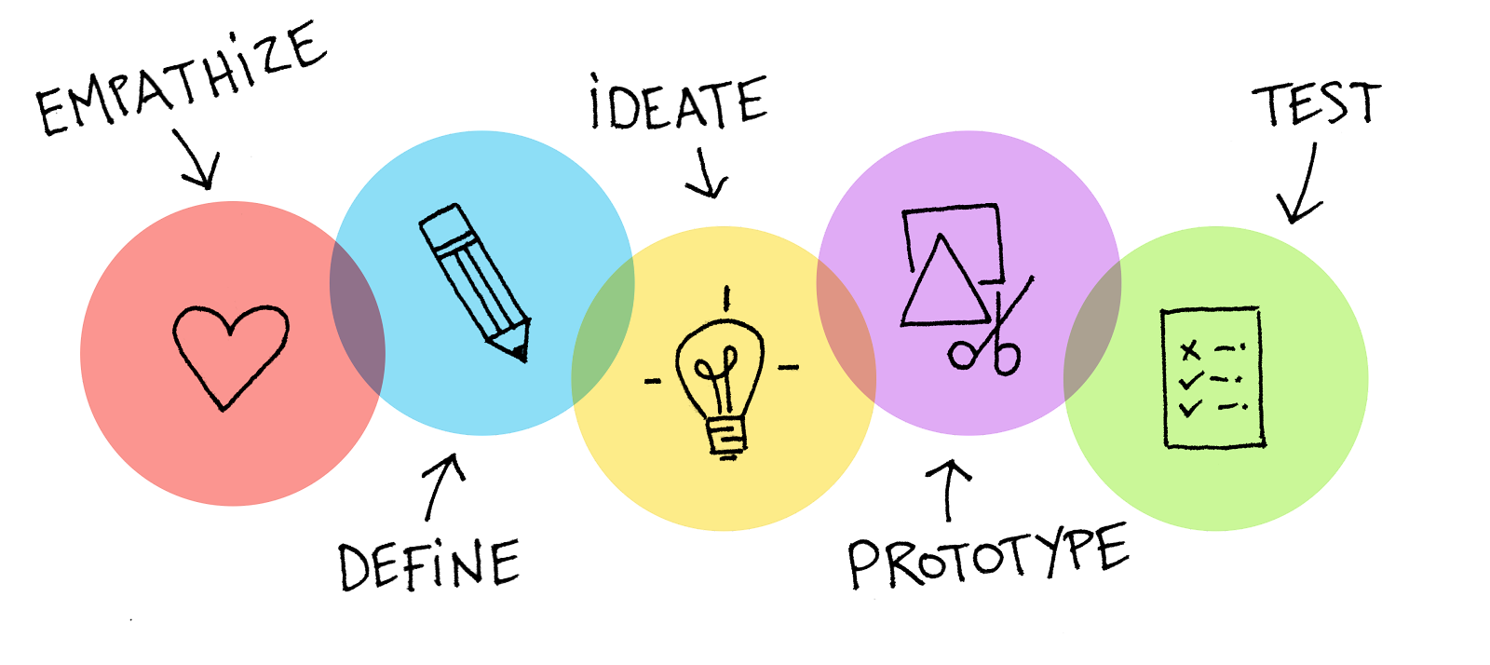
Methodology

Slide 6
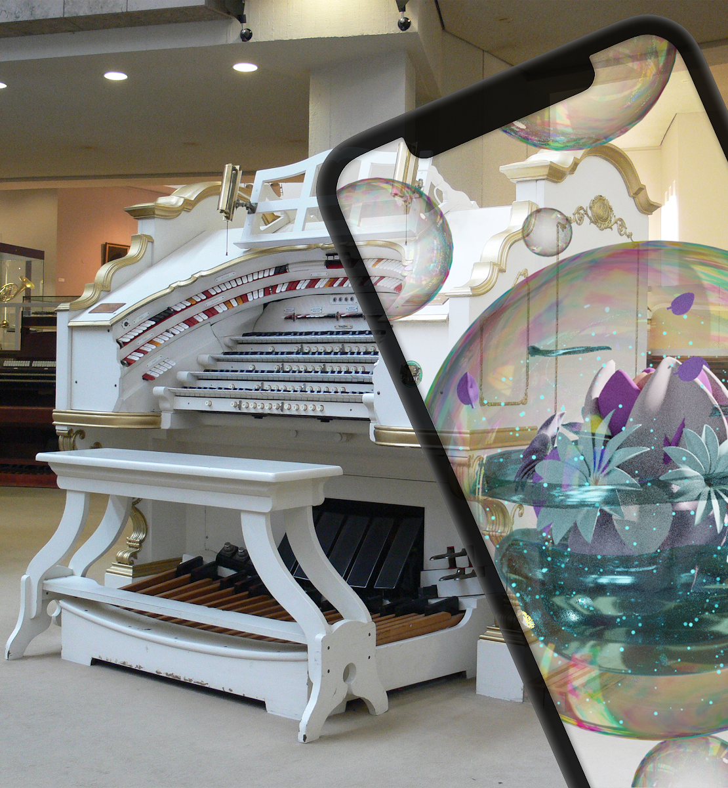
A mobile visitor guide app for the Kulturforum Berlin
Future Walk App
Future Walk is an interactive Storytelling Experience for the Kulturforum in Berlin that connects the surrounding museums and exhibitions in a playful way through a science fiction inspired narrative, interactive soundscapes and location based technology. The narrative experience creatively links the Kulturforum Berlin, Gemäldegalerie, Kunstgewerbemuseum and the Musikinstrumenten-Museum.
During the experience, visitors are led through the Kulturforum by an unknown contact from the faraway future and find themselves engaged in a series of exciting quests.
Google play store
Apple Store

Slide 7
A mobile visitor guide app for the Kulturforum Berlin
Future Walk App
The app offers four different location-based, immersive journeys for the Gemäldegalerie (Old Masters Picture Gallery), Kunstgewerbemuseum (Museum of Decorative Arts), Musikinstrumentenmuseum (Musical Instruments Museum), and an open-air tour in the area of the Kulturforum. The Future Walk app can be extended for further museums and cultural sites by using the same story universe and gaming experience.
This app is part of the project museum4punkt0 - Digital Strategies for the Museum of the Future, sub-project "(De-)Coding Culture. Cultural Competence in Digital Space".
museum4punkt0
NEEEEU

Slide 8
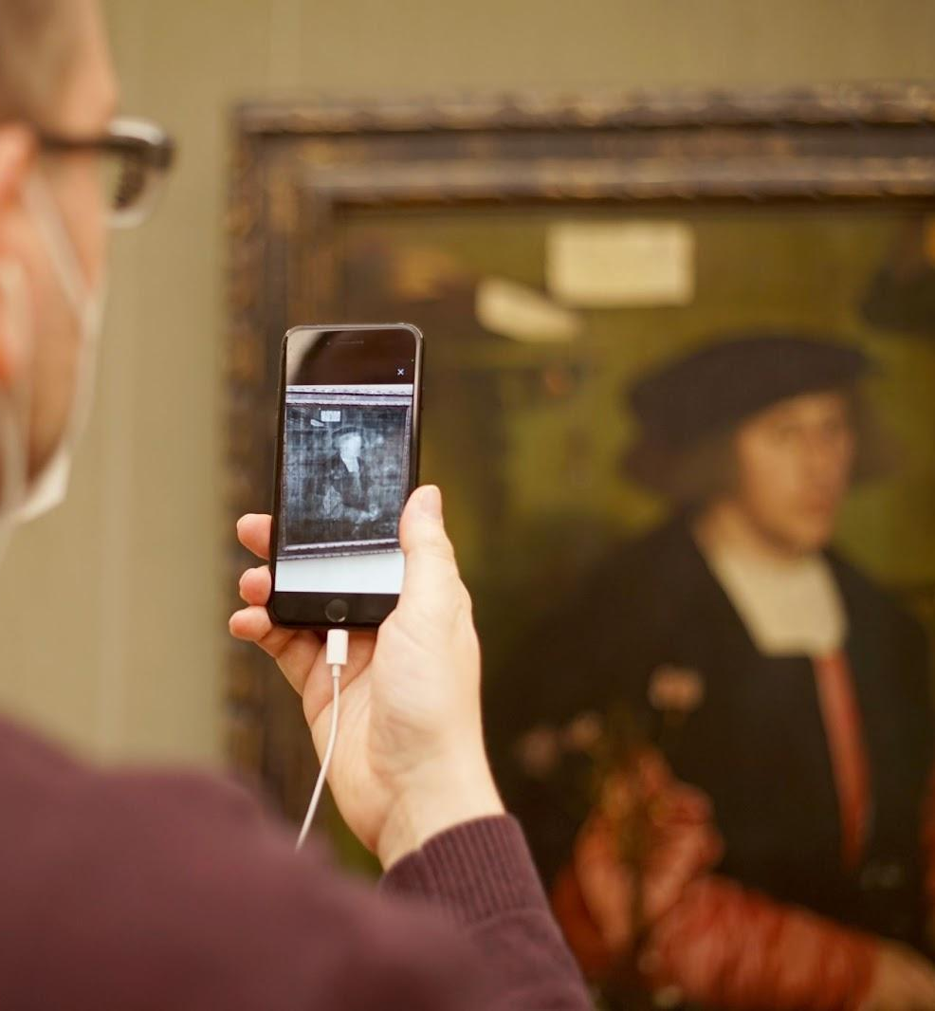
Future Walk
How does it work?
1. Download the app for free.
2. You can start the Future Walk anywhere.
3. Choose the museum you want to visit first: Gemäldegalerie, Kunstgewerbemuseum, Musikinstrumenten-Museum or Kulturforum (outdoor area).
4. Go to the Kulturforum Berlin and get a ticket for your museum visit. The app also offers a free tour through the streets of the Kulturforum.
5. Enjoy the walk, take a pause and come back whenever you want to continue the experience. Each tour lasts between 45 minutes and an hour or longer - depending on your own pace.
www.smb.museum/future-walk

Slide 9
Future Walk
Key Features
Audio track and chat communication with the main character Andrea
Augmented Reality shows hidden information
Content is automatically triggered depending on the location in the museum via Bluetooth beacons or outside via GPS.
Audio description of the spoken text is available
More in-depth information about the objects is offered on extra detail pages.
No personal data is stored by the app.
Languages available: German and English

Slide 10
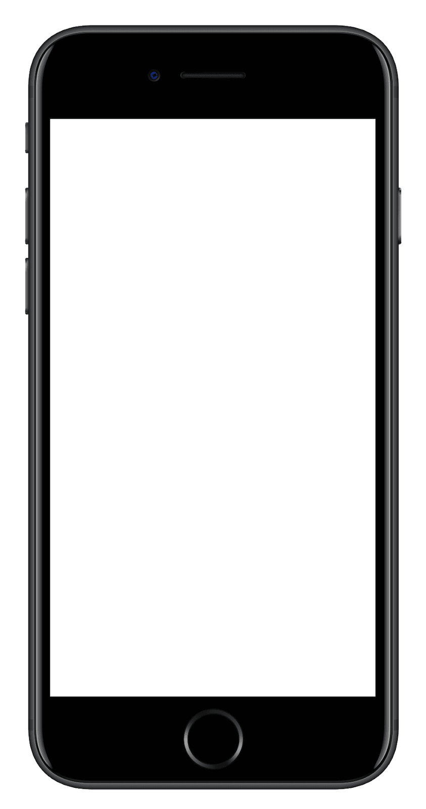
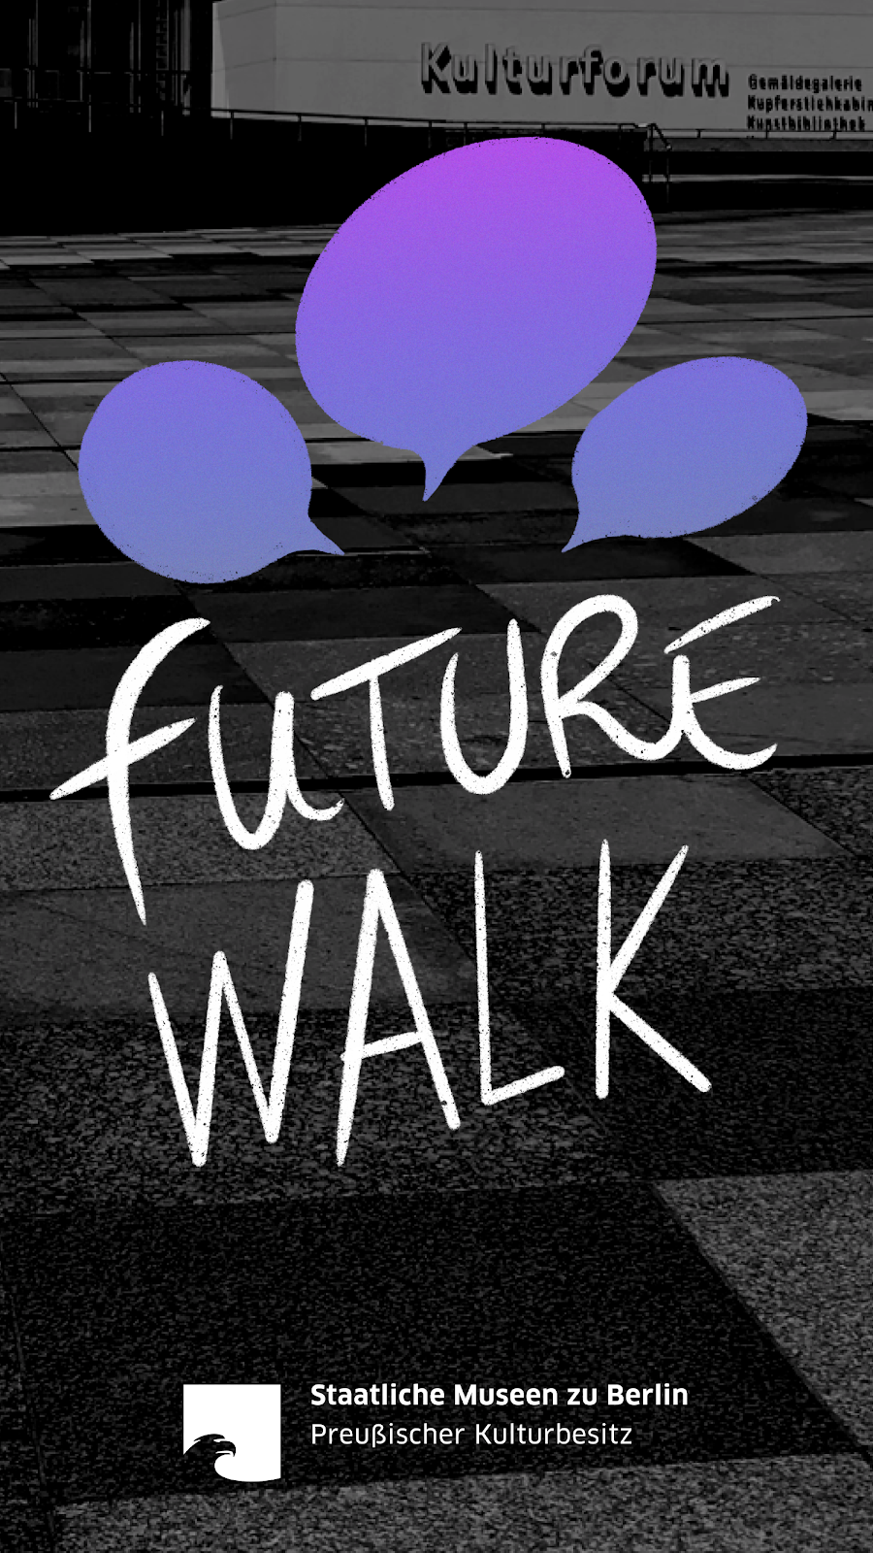
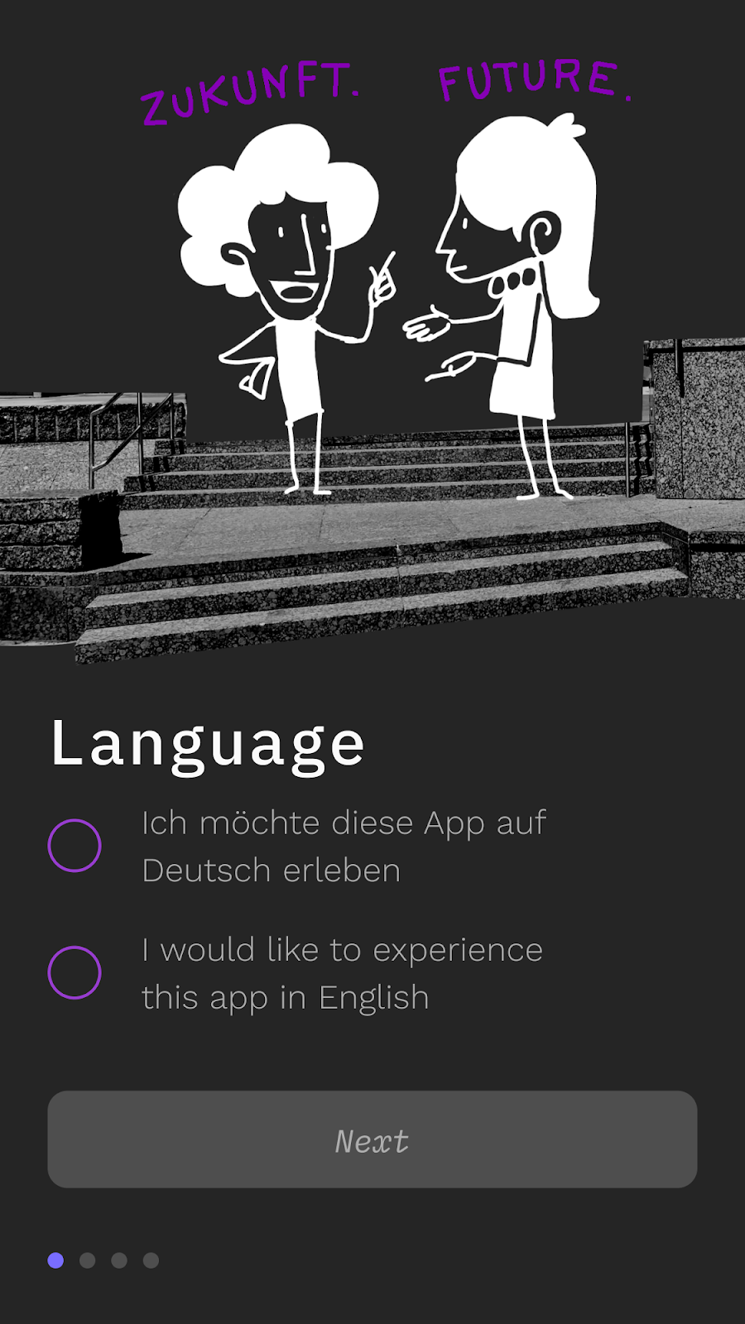
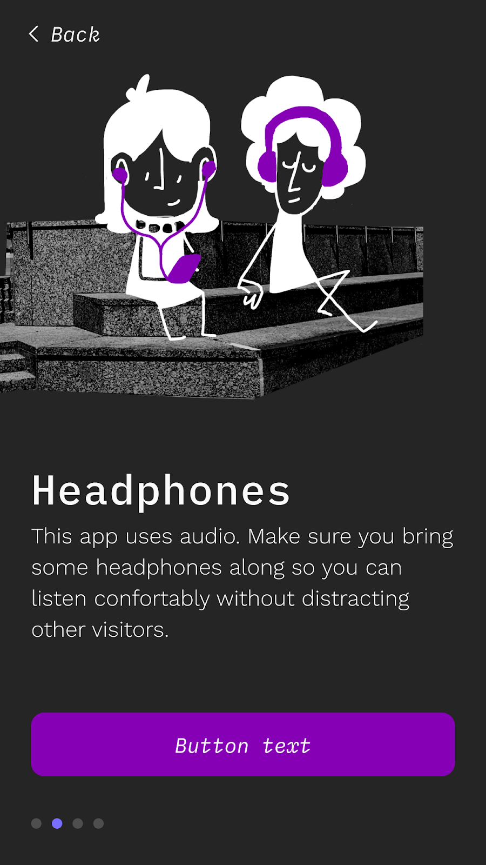
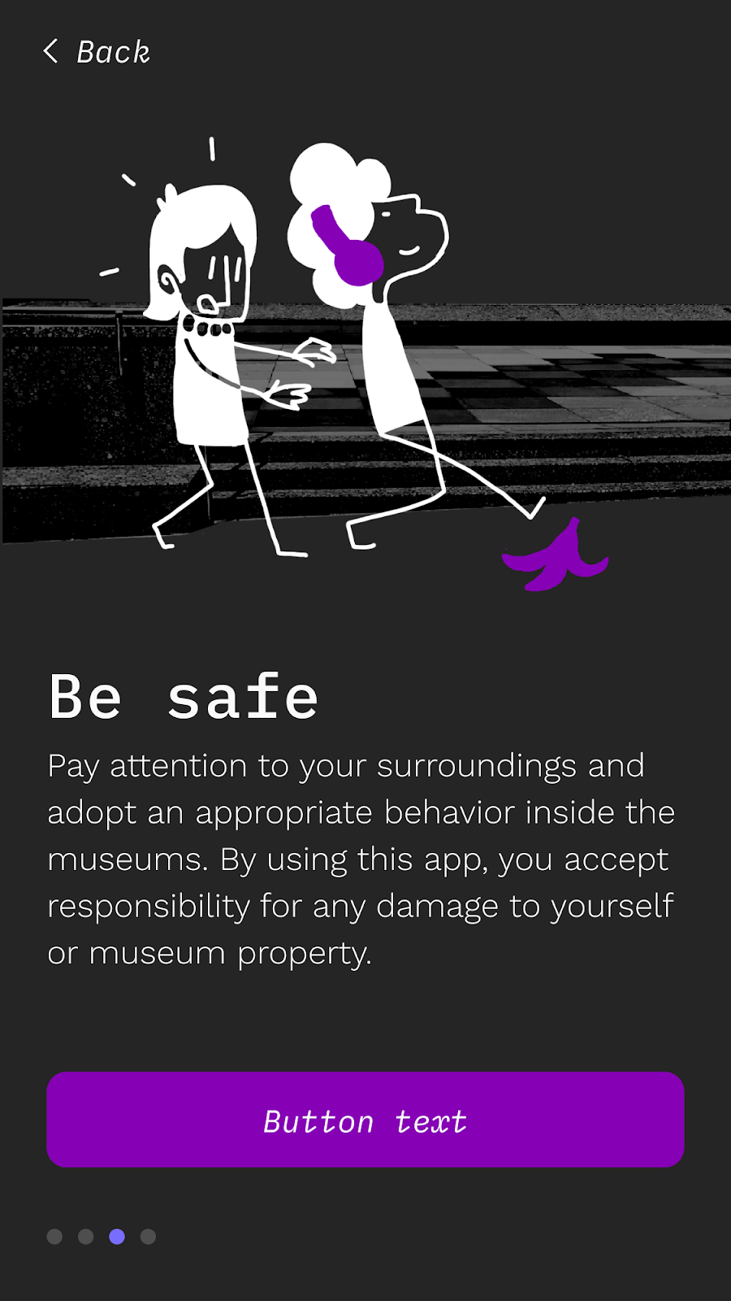
Onboarding
Home screen is followed by language selection page. It’s followed by a screen informing the user that they will need headphones, then a safety warning recommending that they pay attention to their surroundings while using the app.
Next
Next

Slide 11
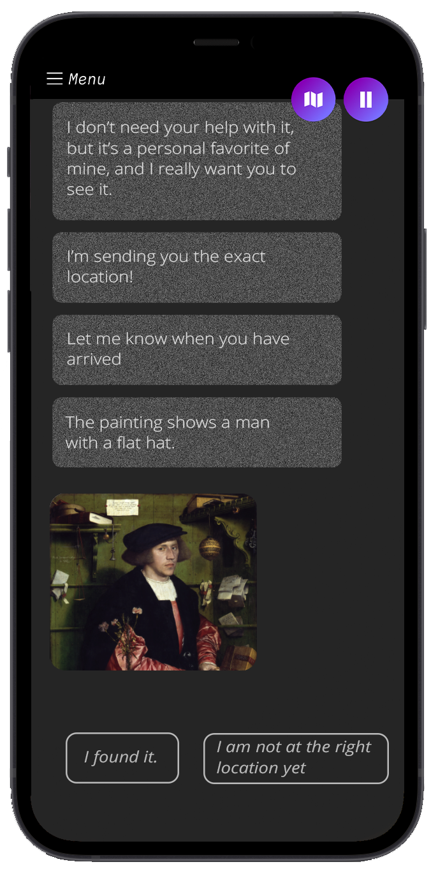
Pause Feature
In the action menu on top of right users can find the map and the pause possibilities.
Point of Interest card
Each point of interest you encounter during the visit is will appear in the chat log and give you access to more information.
Conversation interface
You interact with your Andrea through a simple chat interface, picking from dialog options that change depending on the context.
With a little suspension of disbelief, users will have the illusion that they are chatting with a real person.

Slide 12
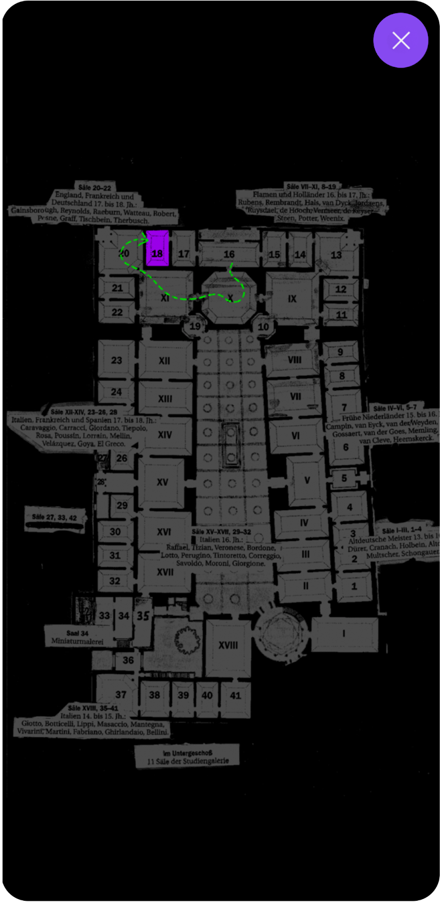
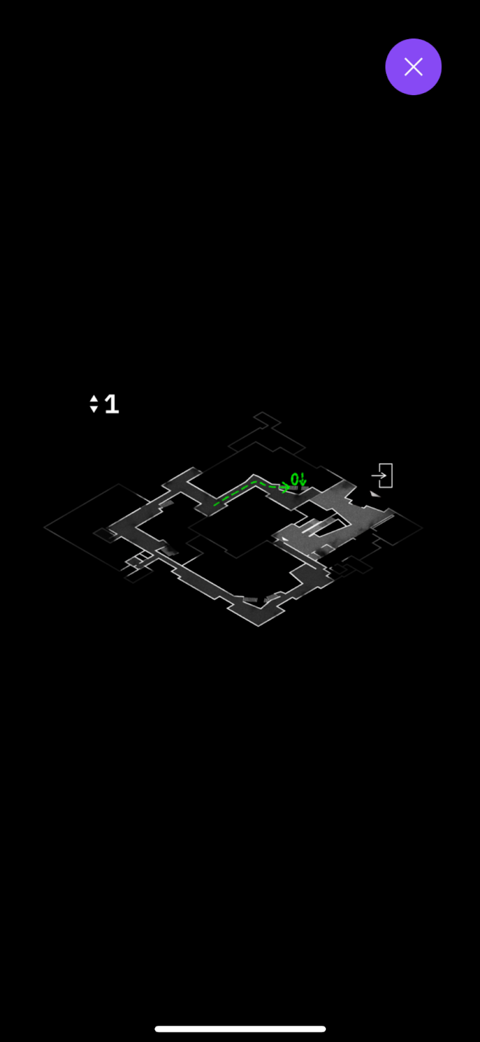
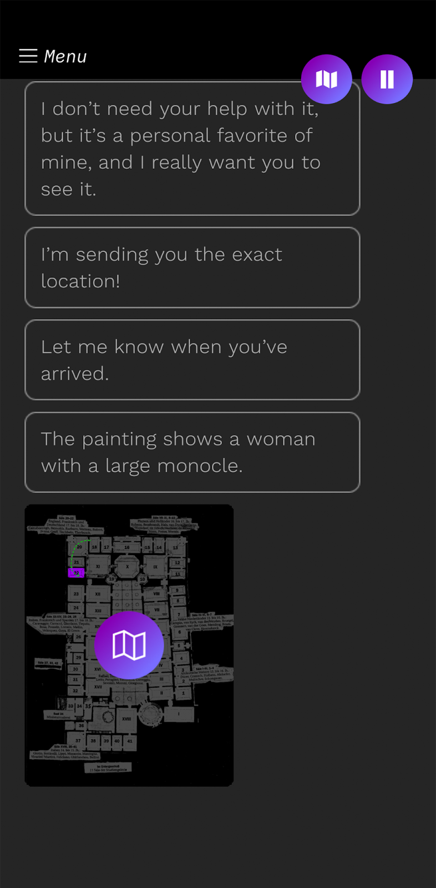
Wayfinding
To help you navigate the space, Andrea sends the user some navigation clues in the form of annotated maps and pictures.

Slide 13
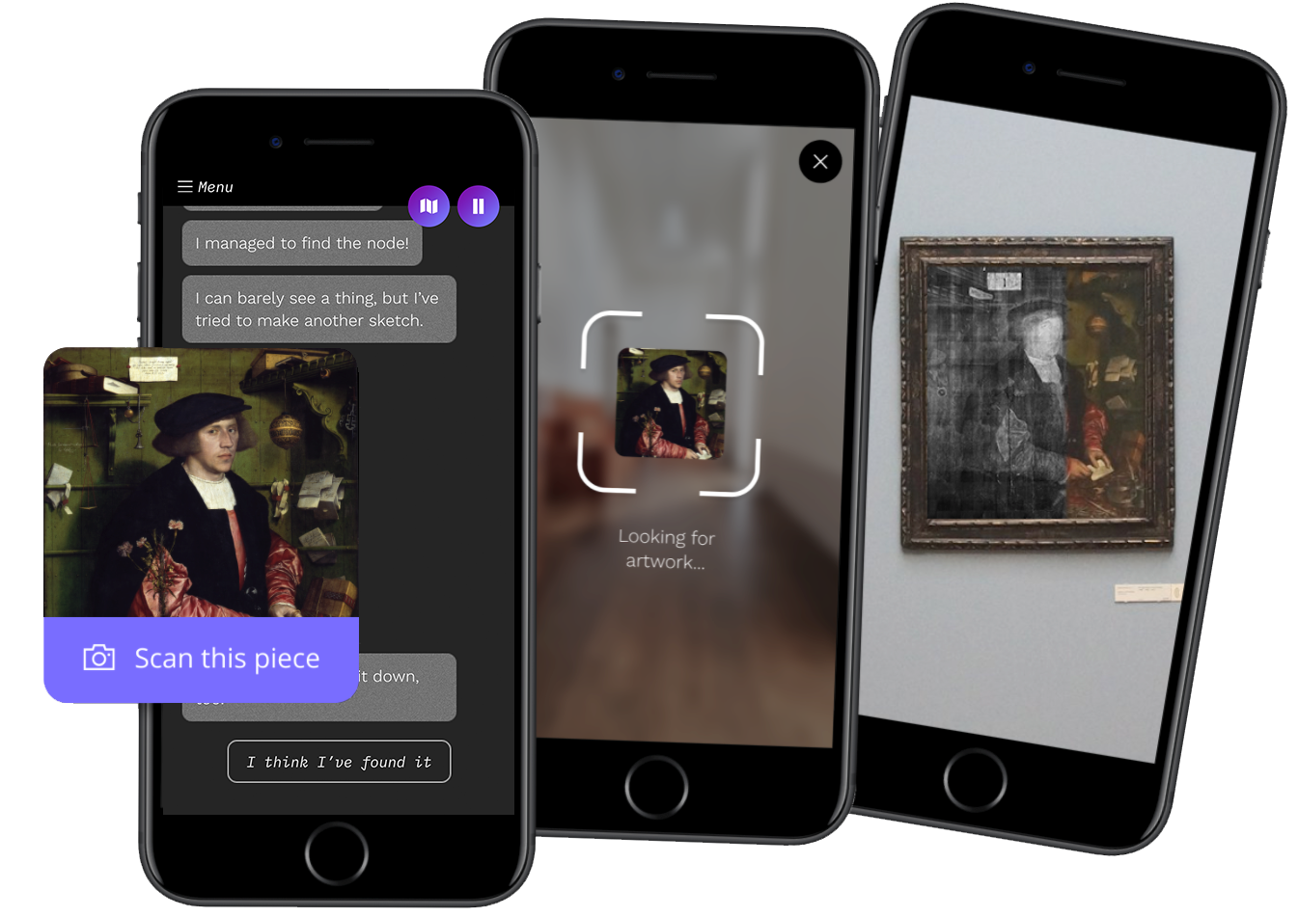
Augmented reality
Users have access to AR highlights which provide contextual information on top of real world objects, such as overlaying an X-ray image over a real painting, revealing the changes made by the artist.

Slide 14
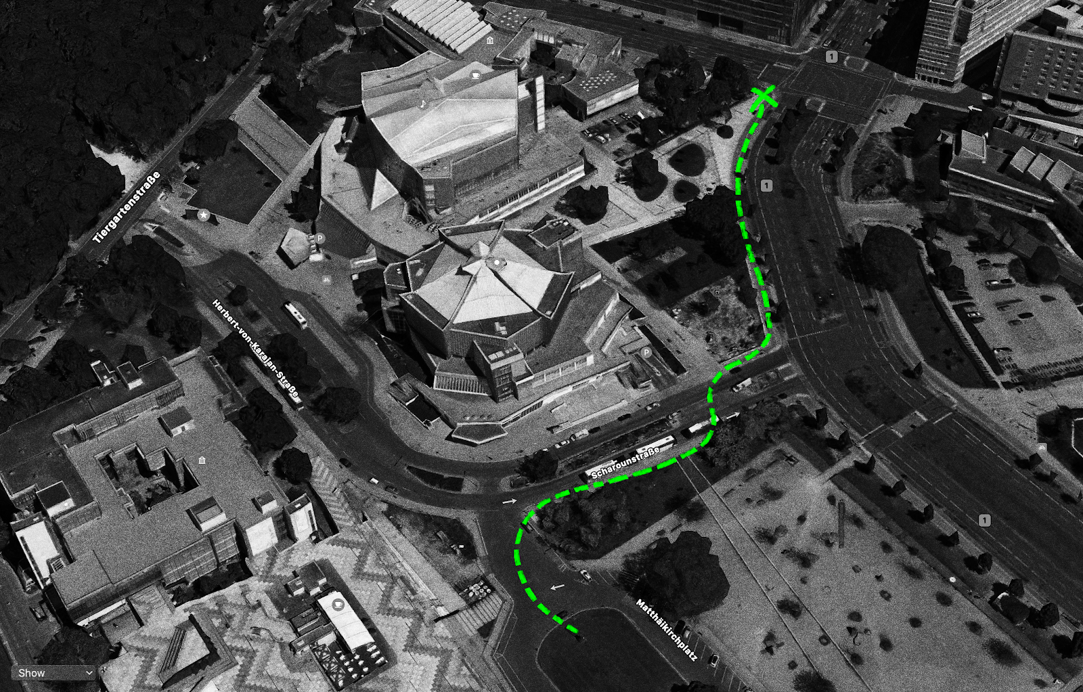
Non-Linear location-based Storytelling
The experience is curated to the different locations identified via the GPS areas in the scripting. When entering the locations, the story evolves providing the audience with an interactive experience that changes each time.

Slide 15
Case Study
Expanding the Auditory AR Feature of the App Future Walk by Staatliche Museen zu Berlin - Preußischer Kulturbesitz
NYU Course: Augmenting the Gallery - WS 2022/23
5. October 2022 / Ceren Topçu-Weigand hello@cerentopcu.com

Slide 16
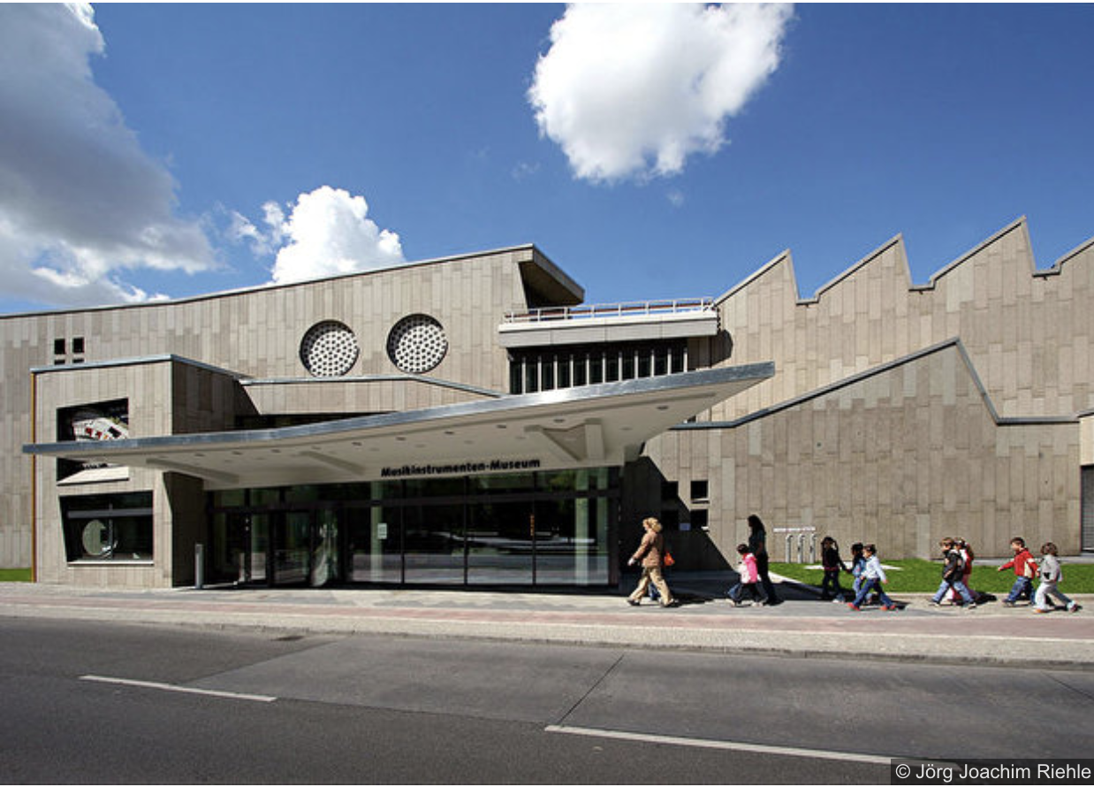
The Museum: Museum of Musical Instruments
Musikinstrumenten-Museum - Stiftung Preußischer Kulturbesitz
An orchestra of more than 800 instruments (of a collection of 3500) from the 16th century to the present day is on display in this museum located at Berlin’s Kulturforum (Culture Forum), behind the gleaming gold Philharmonic building. Objects include a portable harpsichord once owned by Prussia’s Queen Sophie Charlotte, flutes from the collection of Frederick the Great, and Benjamin Franklin’s glass harmonica.
From Baroque wind instruments to precursors to the synthesizer, a variety of rare and little-seen instruments from the ages fill the museum. Visitors can experience the tones of these treasures and find out their histories at listening stations and multimedia terminals.
Google maps

Slide 17
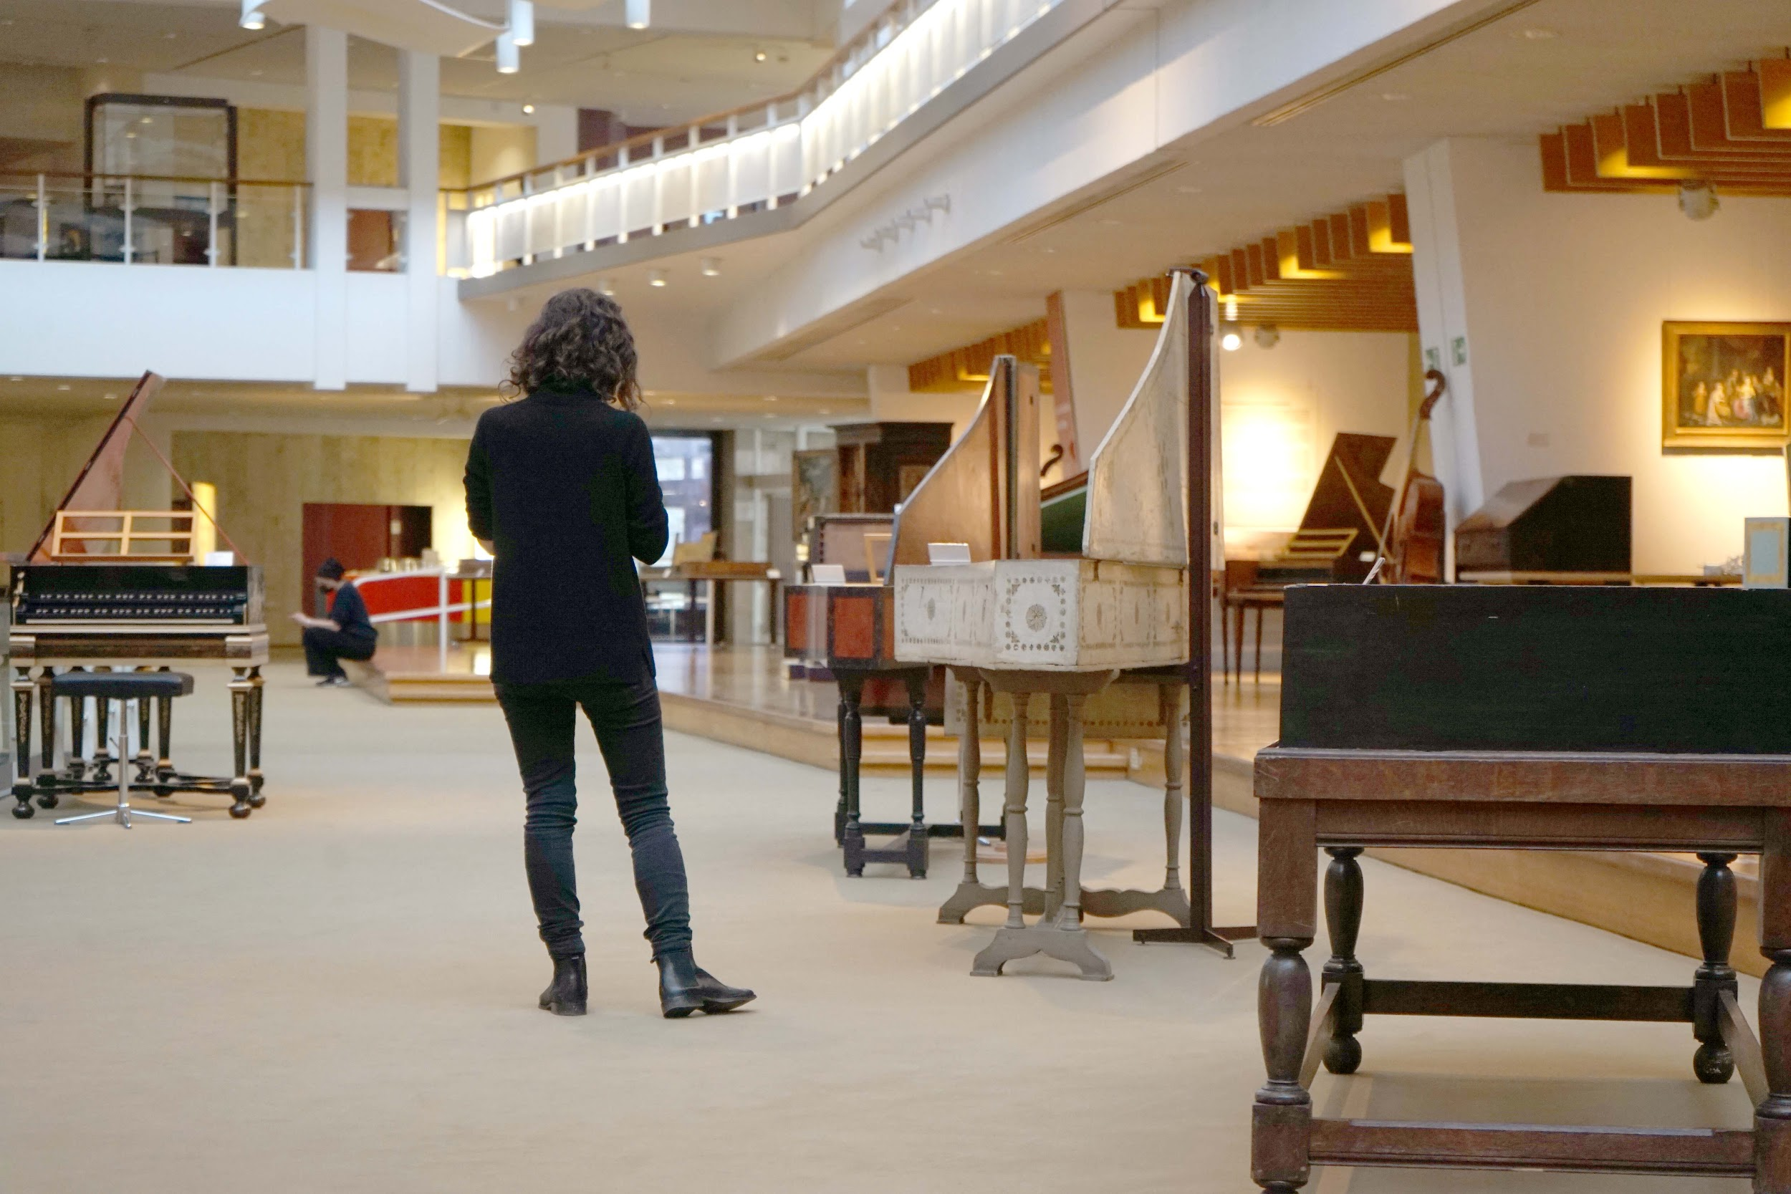
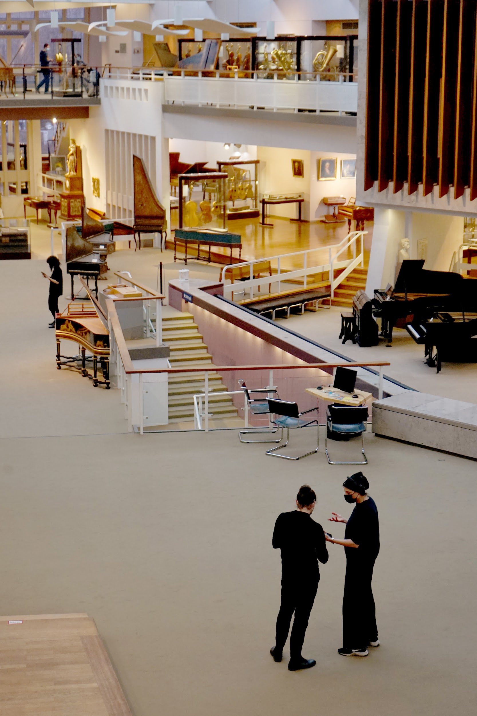
Musikinstrumenten-Museum Berlin - Stiftung Preußischer Kulturbesitz

Slide 18
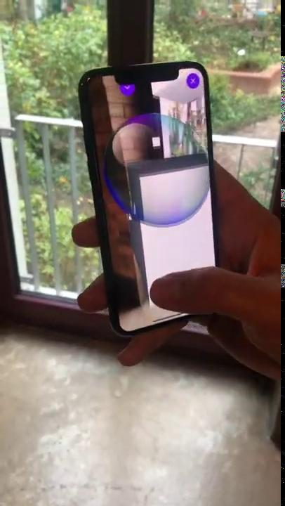

How does the auditory AR work?

Slide 19
Task: Expanding the Auditory AR Feature
Design Challenge:
How can we create an auditory augmented reality interaction to play a musical instrument (without showing the original instrument) in the Museum of Musical Instruments Berlin?
Curatorial Request:
Do not interrupt the visitors, who aren’t using the app.
Content:
Content provided: Sound of the instrument, info about the instrument The map of the museum, The app, The original script of the app. LINK
GitHub Documentation of the Code:

Slide 20
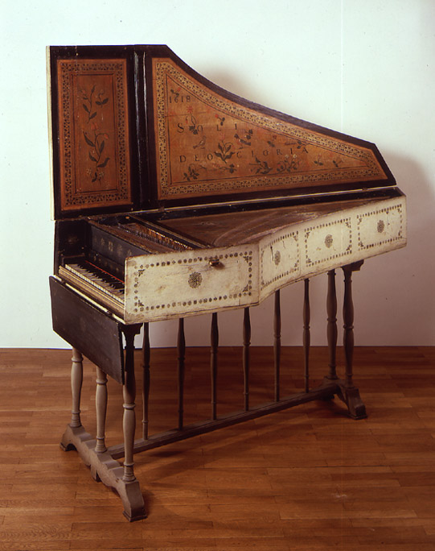
For building harpsichords, the name Ruckers is as substantial as Stradivari is for building violins or Mercedes Benz for building cars. Over several generations that family was able to set new standards in specifics of building their instruments which finally radiated all over Europe. For three generations the Ruckers family crafted outstanding harpsichords in Antwerp and therefore coined Flemish harpsichord making essentially.
More
Harpsichord
Built by: Andreas Ruckers (d.Ä)
Location / Year: Antwerp, 1618
Cat.-No:2224
© Musikinstrumenten-Museum Berlin

